Slide 1
The Foundation High School Program
+ Endorsement (FHSP+E)
2023-2024 Course Selection Information
for High School Students and Parents
Notes:
The information contained in this presentation is accurate as of December 18, 2019. Information will be updated online if/when changes should occur based on Texas Education Agency decisions.

Slide 2
MCHS Assistant Principals & Counselors
Assistant Principals
9th Grade: Chad Onhaizer
10th Grade: James (Jim) Porter
11th Grade: Mary Margaret Crandall
12th Grade: Lauren Garner
Counselors
A-CAL: Therasa (Tracy) Launer
CAM-FLEE: Rebecca Bowman
FLO-H: Santina Lang
I-MEND: Elizabeth Foston-Aragon
MENE-PAT: Jennifer O’Connor
PAU-SEQ: Pam Degges
SER-Z: Adam Sortino

Slide 3
Graduation Requirements

Slide 4
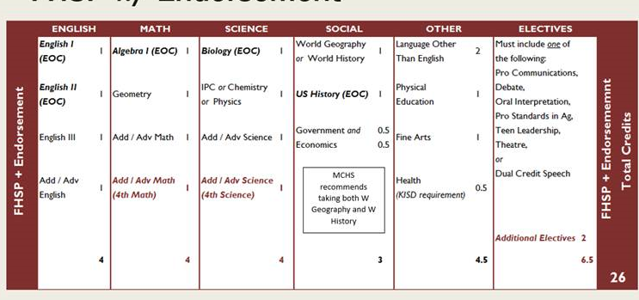
FHSP + Endorsement (26 credits)
Notes:
The Foundation requires 22-credits, while the FHSP + endorsement requires a total of 26 credits, including a fourth math and a fourth science. The four additional endorsement credits are built on top of the foundation.

Slide 5
Distinguished Level of Achievement (DLA)
The Distinguished Level of Achievement (DLA) is earned through successful completion of:
All requirements for the Foundation High School Program, plus
The requirements of at least one endorsement, including
Algebra II among the four required math credits, and
A fourth science credit
A student must graduate with a Distinguished Level of Achievement (DLA) to be considered for the Top 10% and eligibility for automatic admission to a Texas public college or university.
Notes:
Before we go any further, it’s important to note that each of the five endorsements require a fourth math credit and a fourth science credit.
Algebra II is required for the Distinguished Level of Achievement, or DLA.
The DLA is important because it is REQUIRED for the student to be considered for the Top 10% and therefore be eligible for automatic admission to a Texas public college or university.
The requirements for a DLA are pretty much the same as those for any endorsement; but, Algebra II is specified as a requirement for earning the DLA, regardless of which endorsement you choose to pursue.
More information about the importance of Algebra II credit and the DLA and will be covered later in this presentation.

Slide 6
The Endorsements
STEM (Science – Technology – Engineering – Math)
Business & Industry
Public Services
Arts & Humanities
Multidisciplinary Studies
Notes:
There are five endorsement categories. Each one is quite different and has its own requirements.
When selecting the endorsement, students should think about the courses they want to take and their own specific areas of interest.
The endorsements are listed at the top of the course selection sheet.
The course catalog includes information on the endorsements in greater detail, but we will briefly go over each one here.

Slide 7
Basic Information: The Endorsement
All students must choose at least one endorsement in one of 5 areas at the time they enter 9th grade.
The endorsement should be selected based on the student’s individual interests and goals.
Students select and/or confirm the endorsement(s) along with their course selections.
Students have the opportunity to change the endorsement if they choose.
The endorsement choice, and any changes, must be in writing and signed by the student and parent.
Notes:
All students are required to choose an endorsement in one of 5 areas: STEM, Business & Industry, Public Services, Arts & Humanities, or Multidisciplinary Studies. We’ll have more information on the endorsement areas a little later in this presentation.
The endorsement should be chosen based on the student’s individual interests and career goals, and should align with courses the student intends to take while in high school. There are notes throughout the course catalog about which endorsement areas certain courses support.

Slide 8
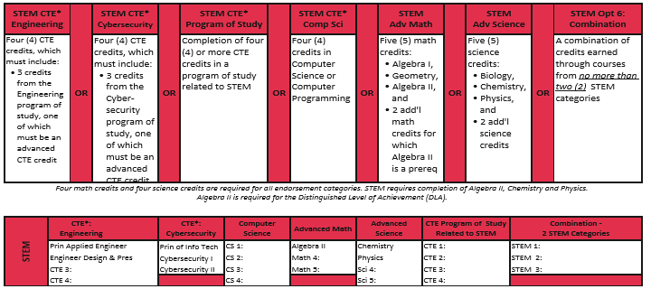
STEM – Science • Technology • Engineering • Math
Notes:
STEM relates to courses of study in advanced math, science, computer science, Career & Technical Education engineering courses, or a combination of courses from up to two of these categories.

Slide 9
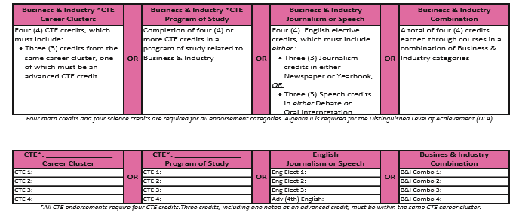
Business & Industry
Notes:
The Business and Industry endorsement includes courses of study from a wide variety of areas of Career & Technical Education, English, in the fields of Journalism or Speech, Technology, or a combination from various Business & Industry categories.

Slide 10
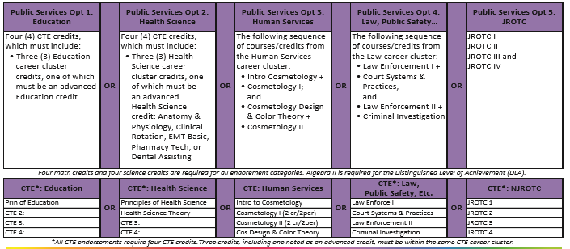
Public Services
Notes:
The Public Services endorsement is comprised of Career and Technical Education courses of study in the areas of Health Science, education, cosmetology, law enforcement and JROTC.
To earn this endorsement, all four CTE credits must be earned in the same category.

Slide 11
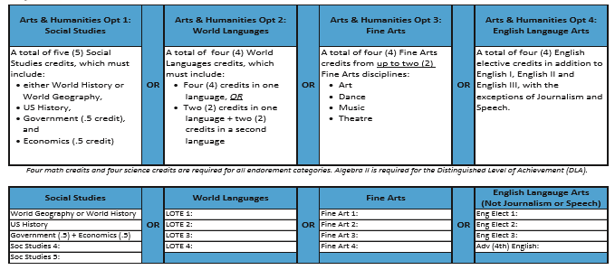
Arts & Humanities
Notes:
The Arts and Humanities endorsement relates to English--other than journalism and speech, Social Studies, Languages Other than English, as well as to each of the fine arts disciplines, including Art, Dance, Music and Theatre.
This endorsement cannot be earned through a combination of courses from different Arts & Humanities categories.

Slide 12
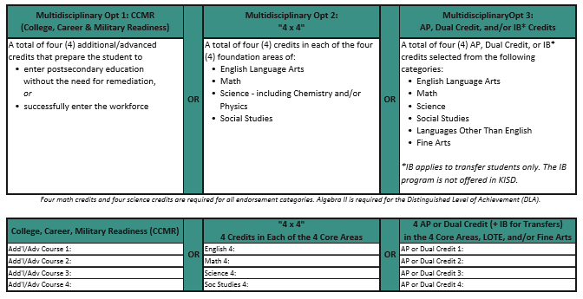
Multidisciplinary Studies
Notes:
The multidisciplinary studies endorsement allows students to select their course of study from several different areas, and there are various ways to earn this endorsement, including college, career and military readiness, the 4X4, and Advanced Placement, Dual Credit, or International Baccalaureate courses.

Slide 13
Course Selection:
The SchooLinks Online Process

Slide 14
SchooLinks Online
Course Selection Dates:
Friday, January 20th through Tuesday, January 31st

Slide 15
Course Selection:
The Steps

Slide 16
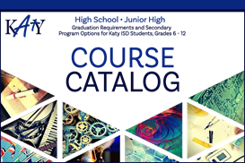
Choosing Courses for Next Year
Choose or review your endorsement
Choose courses from the required subject areas
English
Math
Science
Social Studies
3. Choose courses from other areas to fill all seven class periods
If one course marked (sem) is selected, a second semester course is required.
Notes:
When making course selections, please review the course catalog.
It is important to be aware of any prerequisites, grade restrictions, course fees, or after school commitments associated with different courses and programs. Also, be sure to review “Selecting Courses for the Next School Year” and the Katy ISD schedule change procedures, both on page 35 of the course catalog.
The course selections must include enough courses to fill seven full class periods, and include courses from the required subjects: English, math, science and social studies.
All students are required to take either World Geography or World History; World Geography is an option for 9th grade students.

Slide 17
Choosing Courses for Next Year
Students must be mindful of their endorsement requirements.
Review the course catalog when making selections.
Notes:
When making course selections, please review the course catalog. It is very important to be mindful of the student’s graduation plan and endorsement requirements
Please be aware of any prerequisites, grade restrictions, course fees, or after school commitments associated with different courses and programs. Also, be sure to review “Selecting Courses for the Next School Year” and the Katy ISD schedule change procedures, both on page 35 of the course catalog.
The course selection sheet should be filled out neatly and completely, including alternate choices.
Sometimes a chosen class doesn’t fit in the student’s schedule. It is important to list alternate courses that are of interest to the student just in case one of the first choice classes doesn’t work with the schedule.
Turn in the completed course selection sheet according to campus instructions.
Students will meet individually with the school counselor to review credits and input course requests for next year. The school counselor can help with any questions about course selections.

Slide 18
Choosing Courses: P.E. & Fine Arts
Student-athletes must choose only one athletics program on the course selection sheet.
Band requires special consideration:
If the student is in band but not in athletics, select the band option that gives fall PE credit and spring Fine Arts credit;
If the student is in both athletics and band, the band option for the full year Fine Arts credit .
If the student is going to take a first year dance course for PE credit, choose the appropriate dance course number listed under the Athletics heading.
Notes:
There are some special considerations regarding athletics and fine arts.
If the student is an athlete, only ONE athletics program can be chosen. If the student is a multi-sport athlete, the sport can be changed with the season.
For band and dance courses, it is especially important to choose the right course number, depending on whether the credit will count as PE or fine arts. It

Slide 19
Choosing Courses for Next Year
Warning! You cannot repeat a course for which you have already earned credit. No credit is awarded for a duplicated course.
Notes:
Please be certain to choose the correct classes. If the student is in a high school credit course this year, the same course must not be selected for next year. Credit cannot be earned for a duplicated course.

Slide 20
Course Selection:
Applying to Miller (MCTC)
(11th and 12th Grade Students)

Slide 21
Choosing Courses for Next Year
(11th and 12th Grade Students)
Miller Career & Technology Center is a central site for innovative CTE courses not available at the home campuses. Katy ISD high school students are provided opportunities to explore potential post-secondary options and career experiences.
The deadline to apply to Miller is March 3rd. Please click the following link for more information:

Slide 22
Choosing Courses for Next Year
(11th and 12th Grade Students)
Please make sure and select 7 courses for Mayde Creek High School EVEN if you’ve applied to Miller.
If you are accepted to Miller, the appropriate electives/courses will be dropped from your Mayde Creek schedule to make room for Miller courses.

Slide 24
Items to Consider

Slide 25
Algebra II Notice
Algebra II is not specified as a graduation requirement; however, students who do not earn Algebra II credit are not eligible for:
Earning the Distinguished Level of Achievement (DLA), which requires completion of an endorsement with Algebra II among the four math credits,
Recognition as an honors or high honors graduate,
Automatic admission to a state public college or university, and
Certain financial aid opportunities, including the TEXAS grant or the Texas Educational Opportunity Grant.
Senate Bill 232
Notes:
Earlier in the presentation, we talked about Algebra II credit and the Distinguished Level of Achievement.
Completion of Algebra II is not required; however, not completing this credit has consequences making students ineligible for several important opportunities.

Slide 26
Top 10% Rule
A student whose class rank* is in the top 10 percent of the graduating class may be eligible for automatic admission consideration at a Texas public college or university.
*Class rank must be based on the student’s rank at the end of the 11th grade, middle of 12th grade, or at high school graduation, whichever is most recent at the college or university’s application deadline.

Slide 27
Top 10% Rule
A student in the Top 10% of the graduating class is eligible for automatic admission consideration at Texas public colleges and universities, with the exception of the University of Texas at Austin.
Students in the graduating classes of 2023, 2024 and 2025 who rank in the Top 6% of their class are eligible for automatic admissions consideration at the University of Texas at Austin.

Slide 28
Top 10% Rule
Requirements to qualify for automatic admission consideration:
Complete the FHSP + Endorsement, including the Distinguished Level of Achievement,
Earn a satisfactory ACT or SAT score,
Submit the application before the college or university’s deadline, and
Provide a final high school transcript verifying completion of the FHSP + Endorsement, including the Distinguished Level of Achievement.

Slide 29
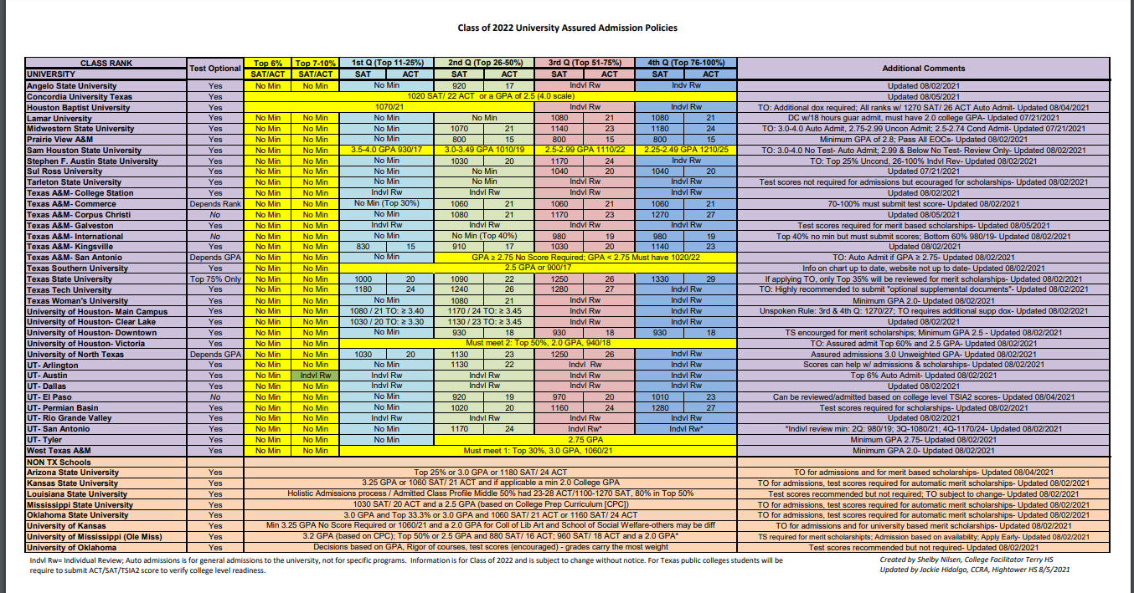
Assured Admission Policy
Beyond the top 10%, students may be eligible for assured admission to many Texas public universities and some out-of-state schools based on quartile class rank and ACT or SAT scores.

Slide 30
Grading Scale for Class of 2023
and Beyond
The alphabetic identification for scores 70-79 is a C.
Students in the top 10% will be provided their numeric class rank in the spring semester of their junior year.
Transcripts will include the numeric class rank only for students in the top 10%.
Students beyond the top 10% will be provided their quartile rank in the spring semester of their junior year.
Notes:
In the fall of 2019, Katy ISD made some significant changes to the grading policy, removing the D from the grading scale. This benefits students by aligning the district grading scale with other school districts in the state, thus allowing Katy ISD students to be competitive in college admissions and scholarship application processes.

Slide 31
Reminders
Online Course Selection Window
January 20th- January 31st
Complete through SchooLinks
Use your Student ID & Password
Questions???
Contact your school counselor

